Slide 1

Phishing Awareness
Training
By
Tohid Bhati
(Cybersecurity Intern at CodeAlpha)

Slide 2
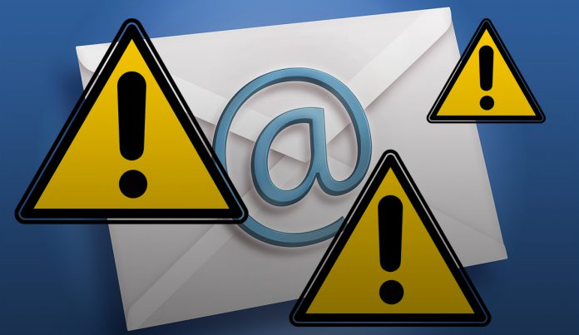
Table of Contents
Introduction to Phishing
Types of Phishing Attacks
Techniques of Phishing
How to recognize Phishing Emails
What to do if a phishing Email is Received
Phishing Campaign For Awareness
Conclusion

Slide 3
Introduction
Phishing is a cybersecurity attack, in which a malicious actor/ hacker sends messages pretending to be a trusted person or an entity.
The goal of phishing attackers is to trick individuals into revealing personall or confidential information.
Phishing attacks can occur via email, text messges, social media, or even phone calls.

Slide 4
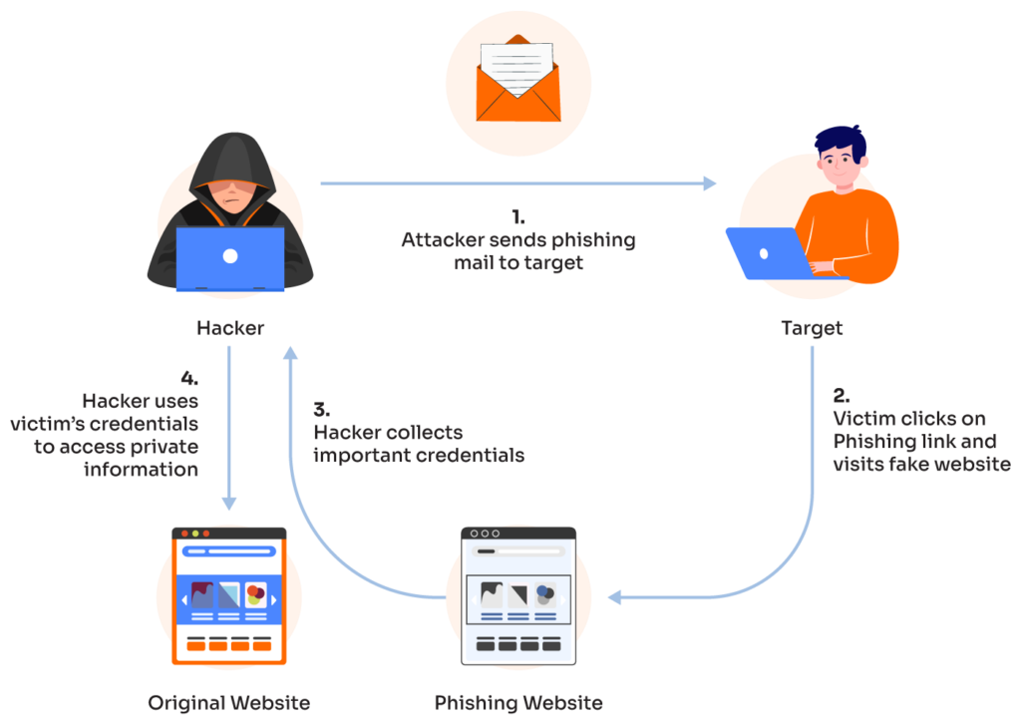

Slide 5
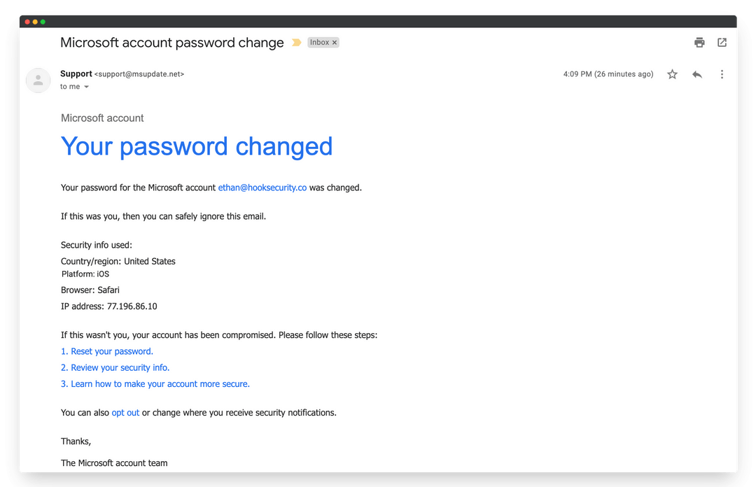
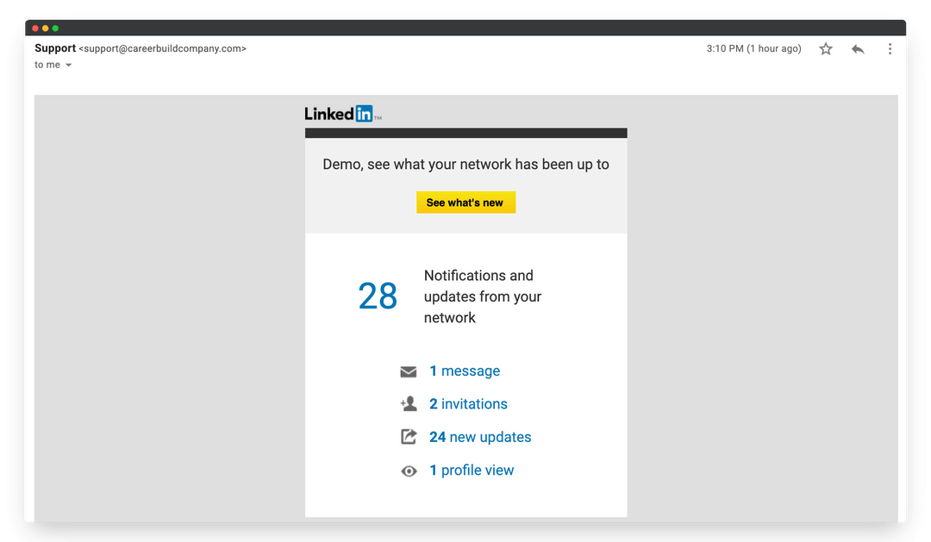
Example:
Fake Emails

Slide 6
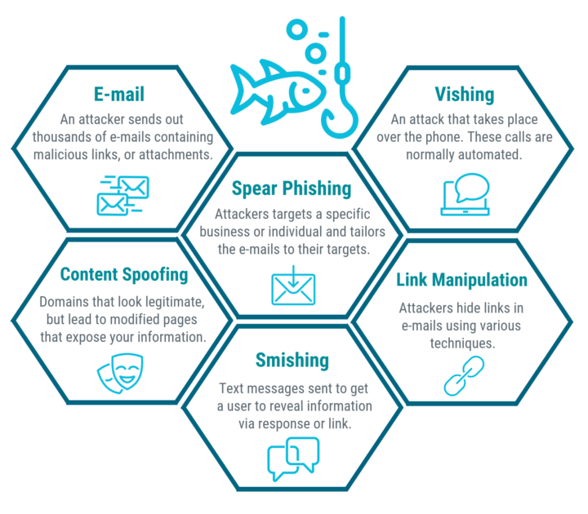
Types Of Phishing Attacks

Slide 7
Common Types of Phishing Attacks
Email Phishing - The most common type where attackers send deceptive emails.
Spear Phishing - Targeted phishing aimed at specific individuals or organizations.
Whaling - Targeting high-profile individuals like executives.
Smishing & Vishing - Phishing through SMS and voice calls, respectively.

Slide 8
Techniques of Phishing
Social Engineering
Typo Squatting
Email Spoofing
URL Shortening
Malicious Redirect
Techniques of Phishing

Slide 9
Techniques Of Phishing
Social Engineering:
  This technique manipulates individuals into divulging confidential information.
  By exploiting trust through deceptive communication, such as fake customer support or urgent requests.
Typo Squatting:
  Attackers create websites with URLs that are common misspellings of legitimate sites.
  Tricking users into visiting these fake pages and disclosing sensitive information.

Slide 10
Email Spoofing:
  Attackers send emails that appear to be from trusted sources by forging the sender's address.
  Tricking recipients into clicking malicious links or providing personal details.
URL Shortening:
  Attackers use shortened URLs to hide the true destination of a link, making it difficult for users to identify if the link leads to a malicious website.
  Often used in phishing attempts on social media or emails.
Malicious Redirect:
  This technique involves redirecting users from legitimate websites to harmful or fraudulent sites without their knowledge
  Typically through compromised web pages or malicious scripts.

Slide 11
How to recognize Phishing Emails
Grammatical and spelling errors in the email.
Urgency or threats demanding immediate action.
Suspicious sender email addressed or URLs that don’t match the purported sender
Links that lead to unfamiliar or suspicious websites

Slide 12
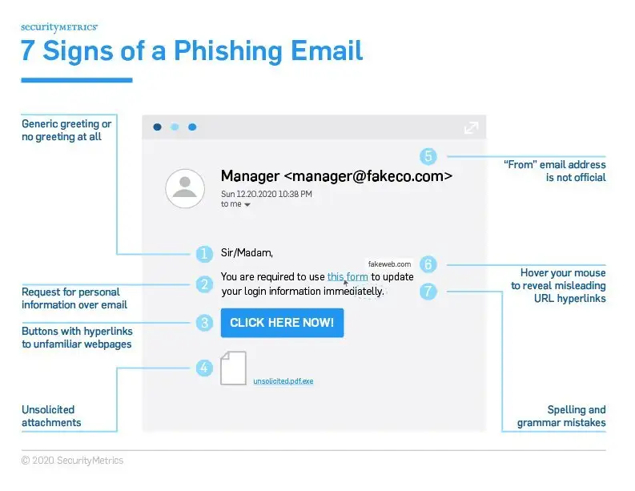

Slide 13
What to do if a phishing email is received
Protecting Yourself From Phishing Attack
1.Verify The Sender
  Always verify the sender’s email address before clicking on any links or providing information.
  Check for the legitimacy of the sender’s domain.
2. Be Skeptical of Urgent Requests
  Be cautious of emails that create a sense of urgency or fear, pressuring you to take immediate action.
  Verify the authenticity of the request through other means before responding.
3. Hover Over Links
  Hover over links to preview the URL before clicking.
  Ensure that the URL matches the purported destination.

Slide 14
4. Use Security Software
  Install and regularly update antivirus and anti-malware software on your devices.
  Enable spam filters on your email accounts.
5. Educate Yourself and Others
  Stay informed about the latest phishing tactics and share knowledge with colleagues, friends, and family.
  Conduct regular phishing awareness training sessions in organizations.
Reporting Phishing Attempts:
  Report Phishing emails to the appropriate authorities, such as your email provider, the Anti=Phishing Working Group (APWG), or the Federal Trade Commission (FTC).
  Provide as much information as possible to help in the investigation and prevention of future attacks.

Slide 15
Phishing Campaign For Awareness
A simulated phishing campaign among employees to increase more awareness
Where, a fake phishing emails is send to every employee to understand how the employee will react to it and what will they do and then train them to protect themselves and recognise or spot the fake emails

Slide 16
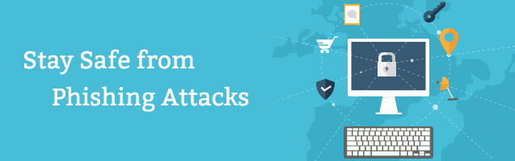
Conclusion
Phishing attacks continue to be a prevalent threat in today’s digital world.
By staying vigilant, educating ourselves and others, and adopting best practices for online security, we can protect ourselves and our organizations from falling victim to phishing scams.

